Slide 1

Customer Relationship Management
By
Samanwaya Bhattacharya
(MST01-0071)
Trainer – Farzana Rashid
Meta Scifor Technologies Pvt. Ltd.
No.13-14, 2nd floor, Kothnur Main Rd, JP Nagar 7th Phase, Bengaluru Karnataka 560078

Slide 2
What is CRM?
Customer Relationship Management (CRM) is a strategy and toolset used by businesses to:
  Manage interactions with customers and potential clients.
  Organize customer data, including contact details, purchase history, and preferences.
  Keep track of the Leads to streamline sales and marketing.
  Enhance relationships and improve customer satisfaction.
In short, CRM helps businesses build long-term, meaningful relationships with their customers while driving growth.

Slide 3
Key Features:
User Authentication
Dashboard
Lead Tracking/Editing and conversion to Client.
Clients Management
Adding Comments
Exporting Clients Details of the user.
Manage Teams

Slide 4
Technologies Used:
Frontend
  HTML
  TailwindCSS
Backend
  Django 5.0.1
Database
  SQLite3(Default database engine)

Slide 5
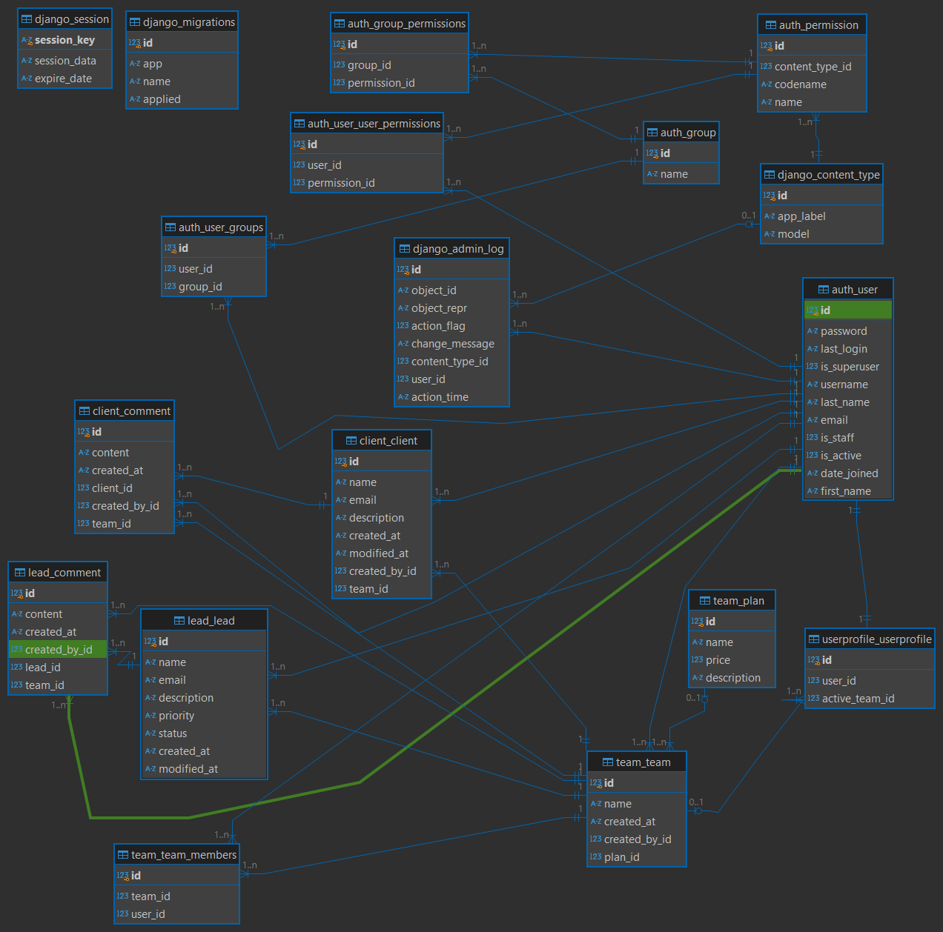
ER Diagram

Slide 6
Future Enhancements
Integration of payment methods for teams and add files for leads.
Integration with smtp gmail services for Email verification of users and enhance user authentication through implementing password resetting functionalities.
Enhanced Team features so that a team owner can manage members of their team.

Slide 7
Conclusion
CRM systems are essential for businesses to manage customer relationships effectively, leading to improved customer satisfaction and loyalty.
Django offers a robust, scalable framework for building CRM applications with features like customer data management, task scheduling, and reporting.
By leveraging CRM, businesses can streamline processes, make data-driven decisions, and ultimately drive growth.

Slide 8
Thank you for your time.
Have a Good Day!

